Slide 1
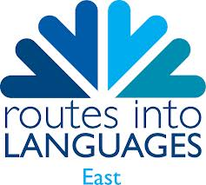
The Real Business Challenge for Modern Language Learners
Coca-Cola Enterprises Ltd. (CCE)'s award- winning national enterprise competition The Real Business Challenge (RBC), has now been adapted as a challenge for students learning French, Spanish or German and a modern language version of the programme is being piloted in East Anglia.
The RBC for Modern Languages, developed by CCE in collaboration with Routes Into Languages East, offers your students the unique chance of working on a live project with business mentors from one of the world’s leading brands and, in doing so, practising another language and developing an even broader range of skills for greater employability.
The programme is free and ready for you to run now. It is aimed at students who are in Year 9 or10 over the 2014/15 academic year and is an exciting business challenge that is linked to the curriculum and supports schools in embedding enterprise education.
Above all, the challenge is fun, engaging and helps learners develop a range of skills that should give them a competitive edge in today’s job market – none more so than the ability to use a modern foreign language.
A unique opportunity to work with a global brand
Free to enter
Supports the teaching of French, Spanish and German
Register here: https://www.routesintolanguages.ac.uk/east/activity/3392

