Slide 1
The Upfest/ Berlin Wall project and the MOOC “Cultural Studies and Modern Languages”
Fiona Malkin (Nailsea School)
Robert Vilain (University of Bristol)

Slide 2
MOOC ‘Cultural Studies and Modern Languages: An Introduction’
Our MOOC is hosted on the FutureLearn platform
FutureLearn was founded by The Open University in 2012
Our MOOC went live for the first time on 16 February 2015
It ran for four weeks and attracted almost 15,000 learners
We have re-run the course once more and are about to re-run for a third time.

Slide 3
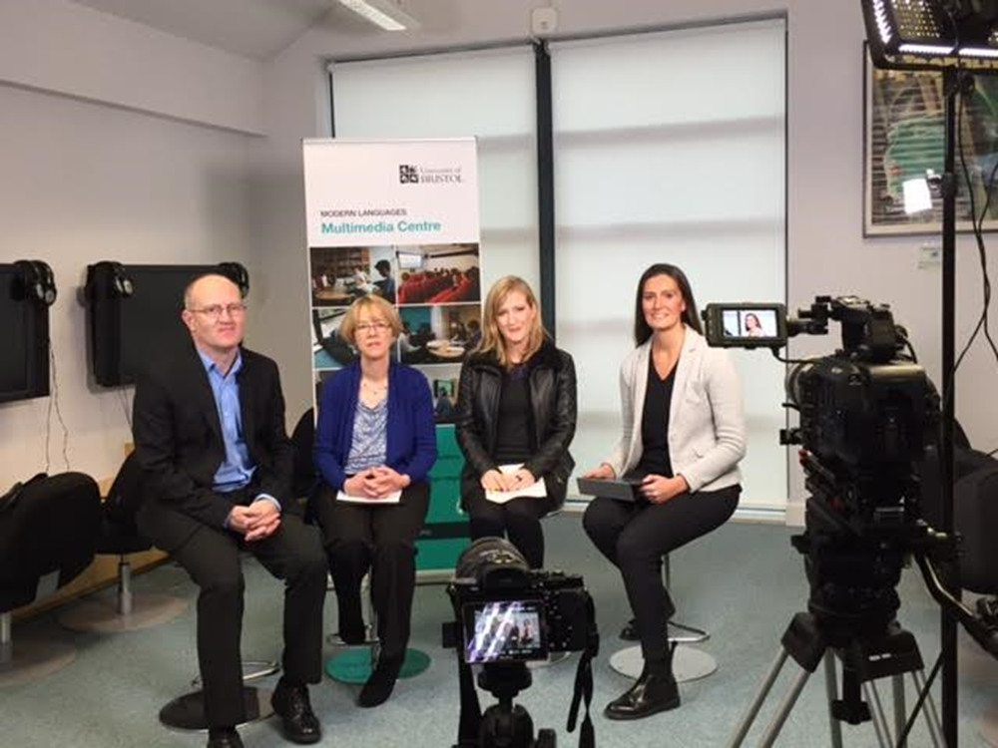
How ‘authentic’ is it?

Slide 4
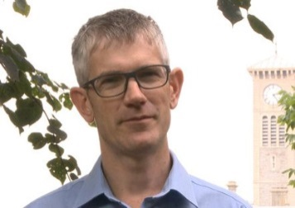
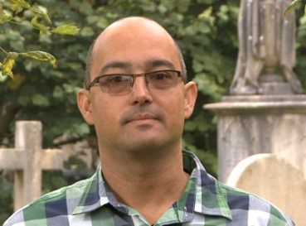
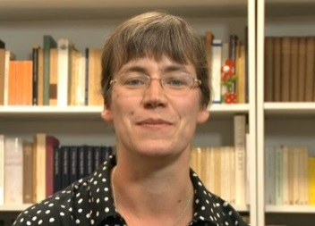
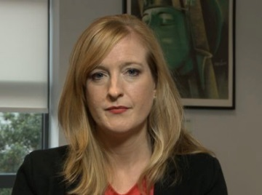
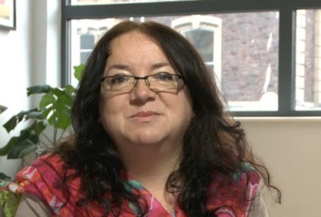
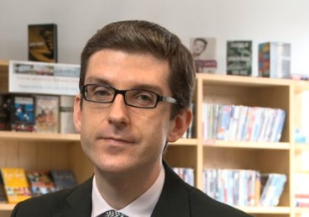
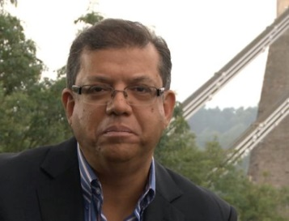
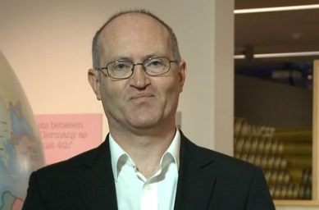
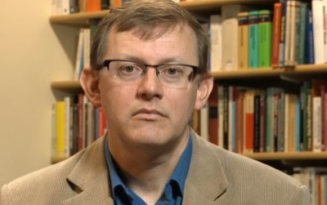
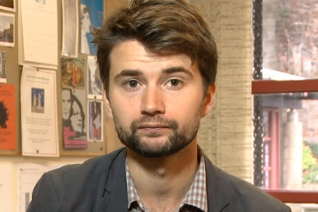
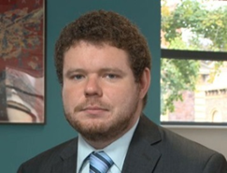
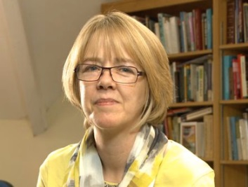
Who’s talking?

Slide 5
What’s in it?

Slide 6
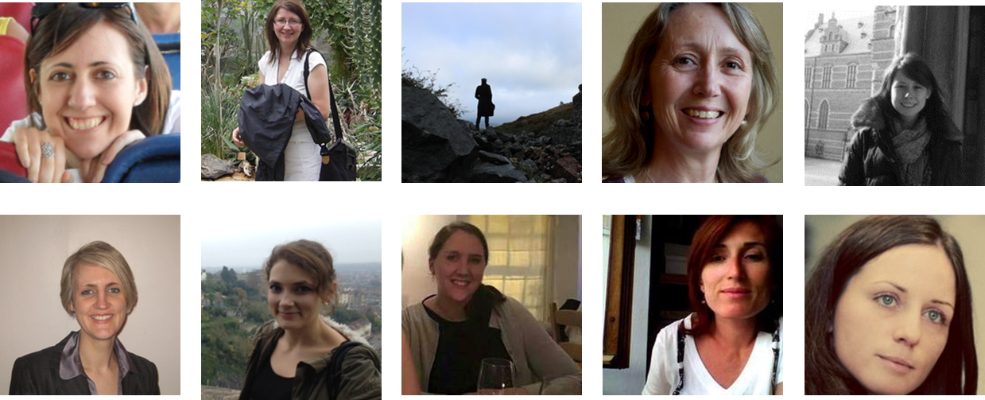
How is it supported?

Slide 7
What does it look like?
https://www.futurelearn.com/courses/cultural-studies

Slide 8
How good was it?
Over 90% of learners rated their overall experience of the course as being good or excellent.
96.43% of the respondents said that the course met or exceeded their expectations.
participants
strongly liked learning via different source materials
found the structure of the course very clear
rated course orientation highly
said the educators were very engaging
found the level of the course, its length and the amount of time require to complete it about right

Slide 9
Feedback
Great course, thanks to everyone involved :)
A brilliant course. This wasn't at all what I thought it was going to be, but I found it extremely interesting and very thought-provoking. Well explained and very well laid out. One of the best course I've done so far. Thanks to everyone involved
Gloria and the whole team - I can only say again what a superb course this was: superbly constructed, efficiently executed plus the benefit of your erudite team of presenters who were even better in the discussion sessions.
I am very thankful to the TEAM for creating such an engaging and well-structured course. During those four weeks I learnt a lot and enriched my knowledge about other cultures. I didn't participate in discussions, but I enjoyed reading the comments. I haven't missed even a single activity and I am really proud to study along with people who know so much about the world around. The most exciting part for me was feedback sessions.

