Slide 1
Oxford German Olympiad A national initiative from the Oxford German Network
Katrin Kohl
Faculty of Medieval and Modern Languages
University of Oxford

Slide 2
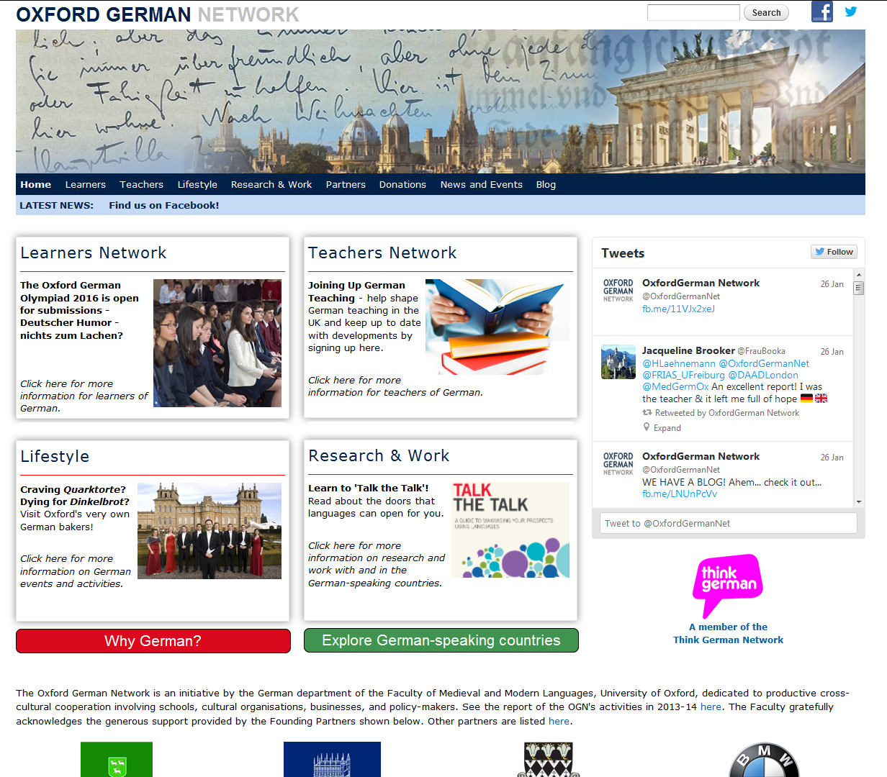

Slide 8
The Oxford German Olympiad is supported by…

Slide 9
Past Olympiads
2013 – “Grimm Tales”
2014 – “1914”
2015 – “Von Pop bis Poesie” (Music & Poetry)
Prizes donated by:

Slide 10
Typical Olympiad tasks…
Design a poster
Create a comic strip
Write a review
Write a short story in response to a German-language text
Create a short film
Design a game / exhibition

Slide 11
Past ‘Round 2’ Competitions
Networking in German – SAP
Kafkaesque Stories – Oxford Kafka Research Centre
German for the Future – Goethe Institut
Eine Deutsche Bahnreise – Deutsche Bahn / German Youth Hostel Association
A Witness to the Holocaust – Wiener Library, London
Camden House Book Proposal – Camden House / Boydell & Brewer

Slide 12
Funding from Routes into Languages goes towards…
Competition design
Competition administration
Judging
Additional / supplementary prizes (e.g. book tokens) & postage
Award ceremony venue
Award ceremony speaker
Award ceremony catering

Slide 13
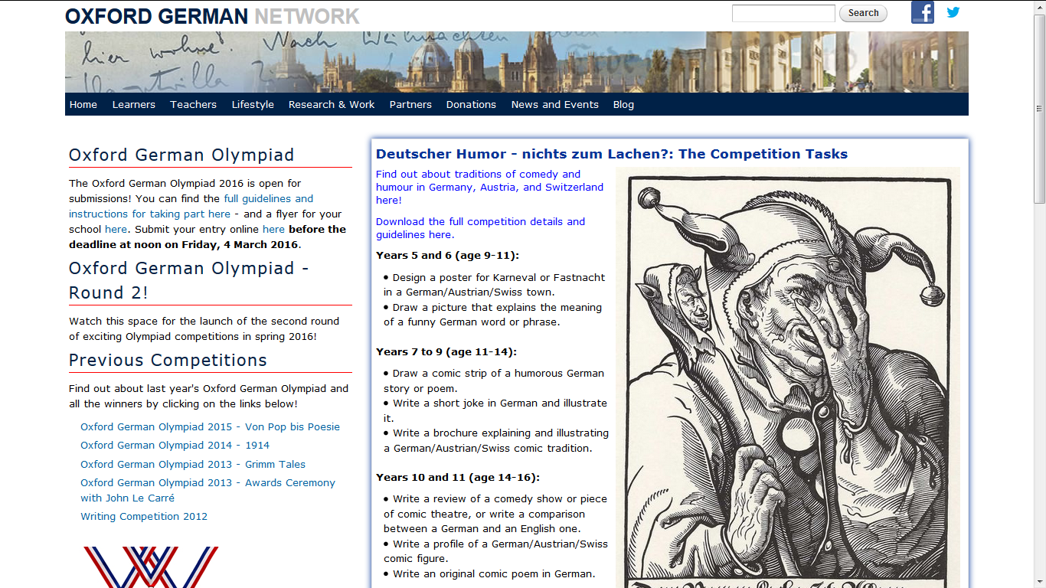

Slide 14
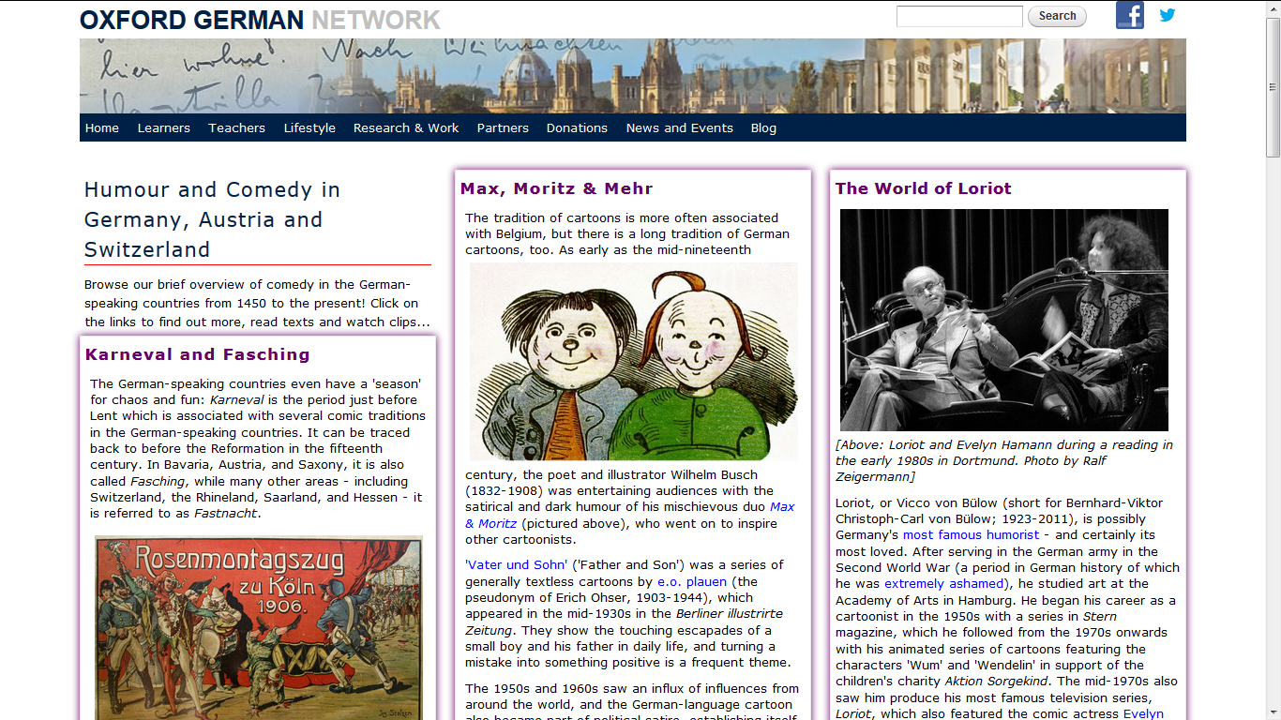

Slide 15
Participant in 2014: ‘I’m incredibly excited to come to Oxford for the ceremony – the competition was lots of fun to do!’
Participant in 2014: ‘A great idea to boost the popularity of learning German in school!’
Participant in 2014: ‘amazing and wonderful competition’
Teacher in 2014: ‘The recognition of [students’] achievements… and [the] opportunity to meet other pupils studying German…I would definitely encourage more of my pupils to enter this next year.’
Teacher of participant in 2015: ‘Personally, I would like to thank the Oxford German Network for providing this opportunity for students of German, as such initiatives are extremely valuable resources in the teaching of German.’
Participant in 2015: ‘Wow…! It was great fun writing the essay and learning about the life of Mozart and of the Kaiserin.’
State school teacher in 2015: ‘There is huge excitement here at the school owing to the great results in the Olympiad this year.’
Teacher in 2016: ‘Our kids really enjoy it every year.’

