Slide 1
El Día de los Muertos
'the Mexican is familiar with death, jokes about it, caresses it, sleeps with it, celebrates it; it is one of his favourite toys and his most steadfast love’
Octavio Paz.
The crafts produced for 'El Dia de los Muertos' are a celebration of this spirit

Slide 2
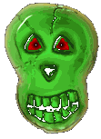
El Dia de los Muertos, the Day of the Dead, is a Mexican tradition and holiday honouring the dead. It is celebrated every year at the same time as Halloween and the Christian holy days of All Saints Day and All Souls Day (November 1st and 2nd). El Dia de los Muertos is not a sad time, but on the contrary a time of remembering and rejoicing.

Slide 3
The townspeople dress up as ghouls, ghosts, mummies and skeletons (esqueletos)and parade through the town carrying an open coffin (atáud).
The "corpse“ smiles as it is carried through the narrow streets of town. The local vendors toss oranges inside as the procession makes its way past their markets.
Lucky "corpses" can also catch flowers, fruits, and candies.

Slide 4
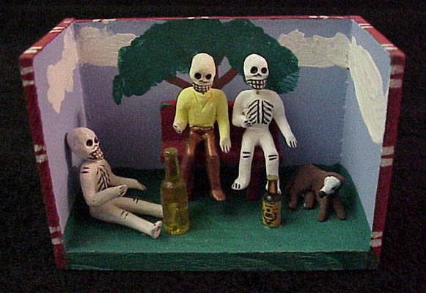
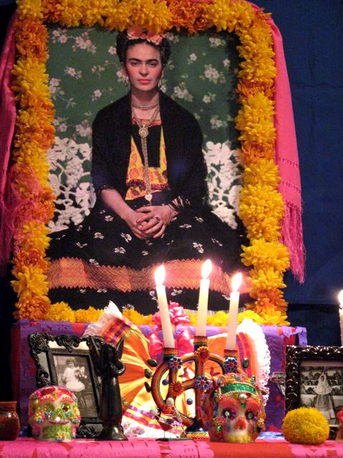
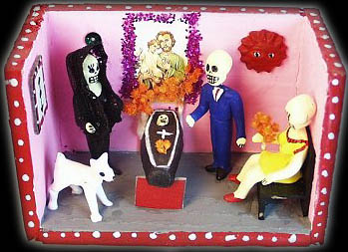
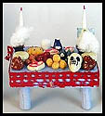
In the homes families arrange ofrendas or altares with flowers, bread, fruit and candy. Pictures of the deceased family members are added. In the late afternoon special all night burning candles are lit - it is time to remember their family and loved ones who have departed.

Slide 5
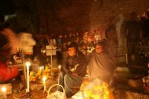
The next day the families travel to the cemetery. They arrive with hoes, picks and shovels. They also bring flowers, candles, blankets, and picnic baskets. The whole family have come to clean and polish the graves of their loved ones. The grave sites are weeded and tidied. The crypts are scrubbed and swept. Colourful flowers, bread, fruit and candles are placed on the graves. Some bring guitars and radios to listen to. The families will spend the entire day and some into the night in the cemeteries.

Slide 6
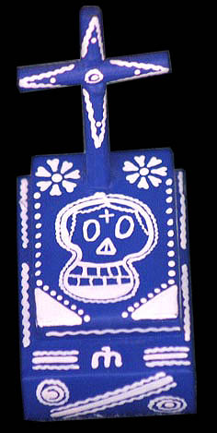
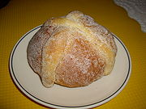
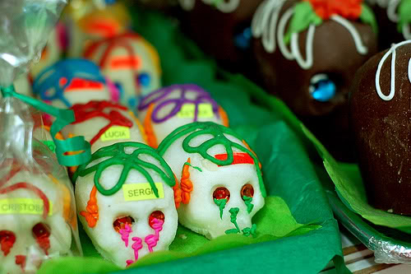
Skeletons “esqueletos” and skulls “craneos” are depicted on celebratory food made for the occasion, as well as black and white chocolate skulls and skeletons and marzipan coffins. Special loaves of bread are baked, called “pan de muertos”and decorated with bones “huesos”

Slide 7
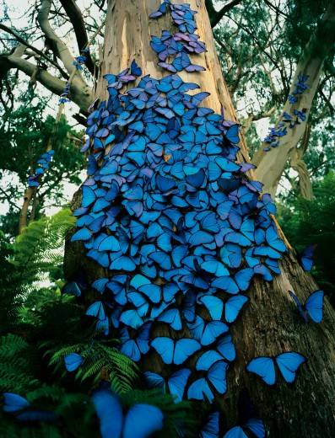
Every autumn Monarch Butterflies, which have summered up north in the United States and Canada, return to Mexico for the winter protection of the oyamel fir trees. The local inhabitants welcome back the returning butterflies, which they believe bear the spirits of their departed, who are honoured during El Día de los Muertos

Slide 8
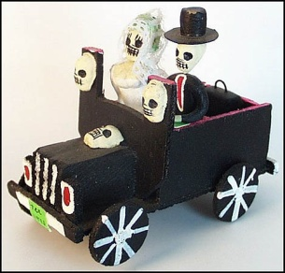
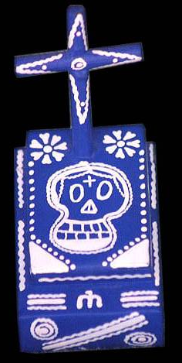
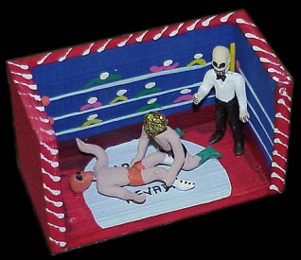
El esqueleto
El cráneo
Los amigos con cervezas
La mariposa
La mesa con comida
El niño prende una vela
La tumba
Los novios en su viaje de bodas
El funeral
Los luchadores

Slide 9
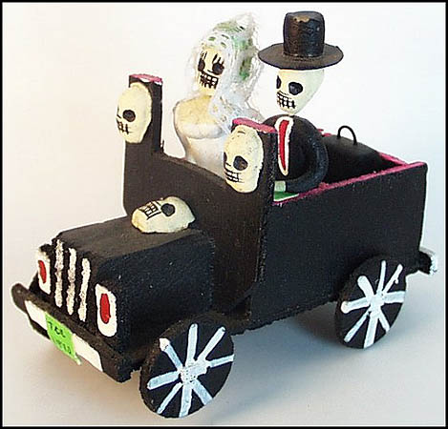

Slide 10
https://www.youtube.com/watch?v=CYyRibaMQoA

Slide 11
http://www.youtube.com/watch?v=sUUAgEWeYeI

